Slide 1

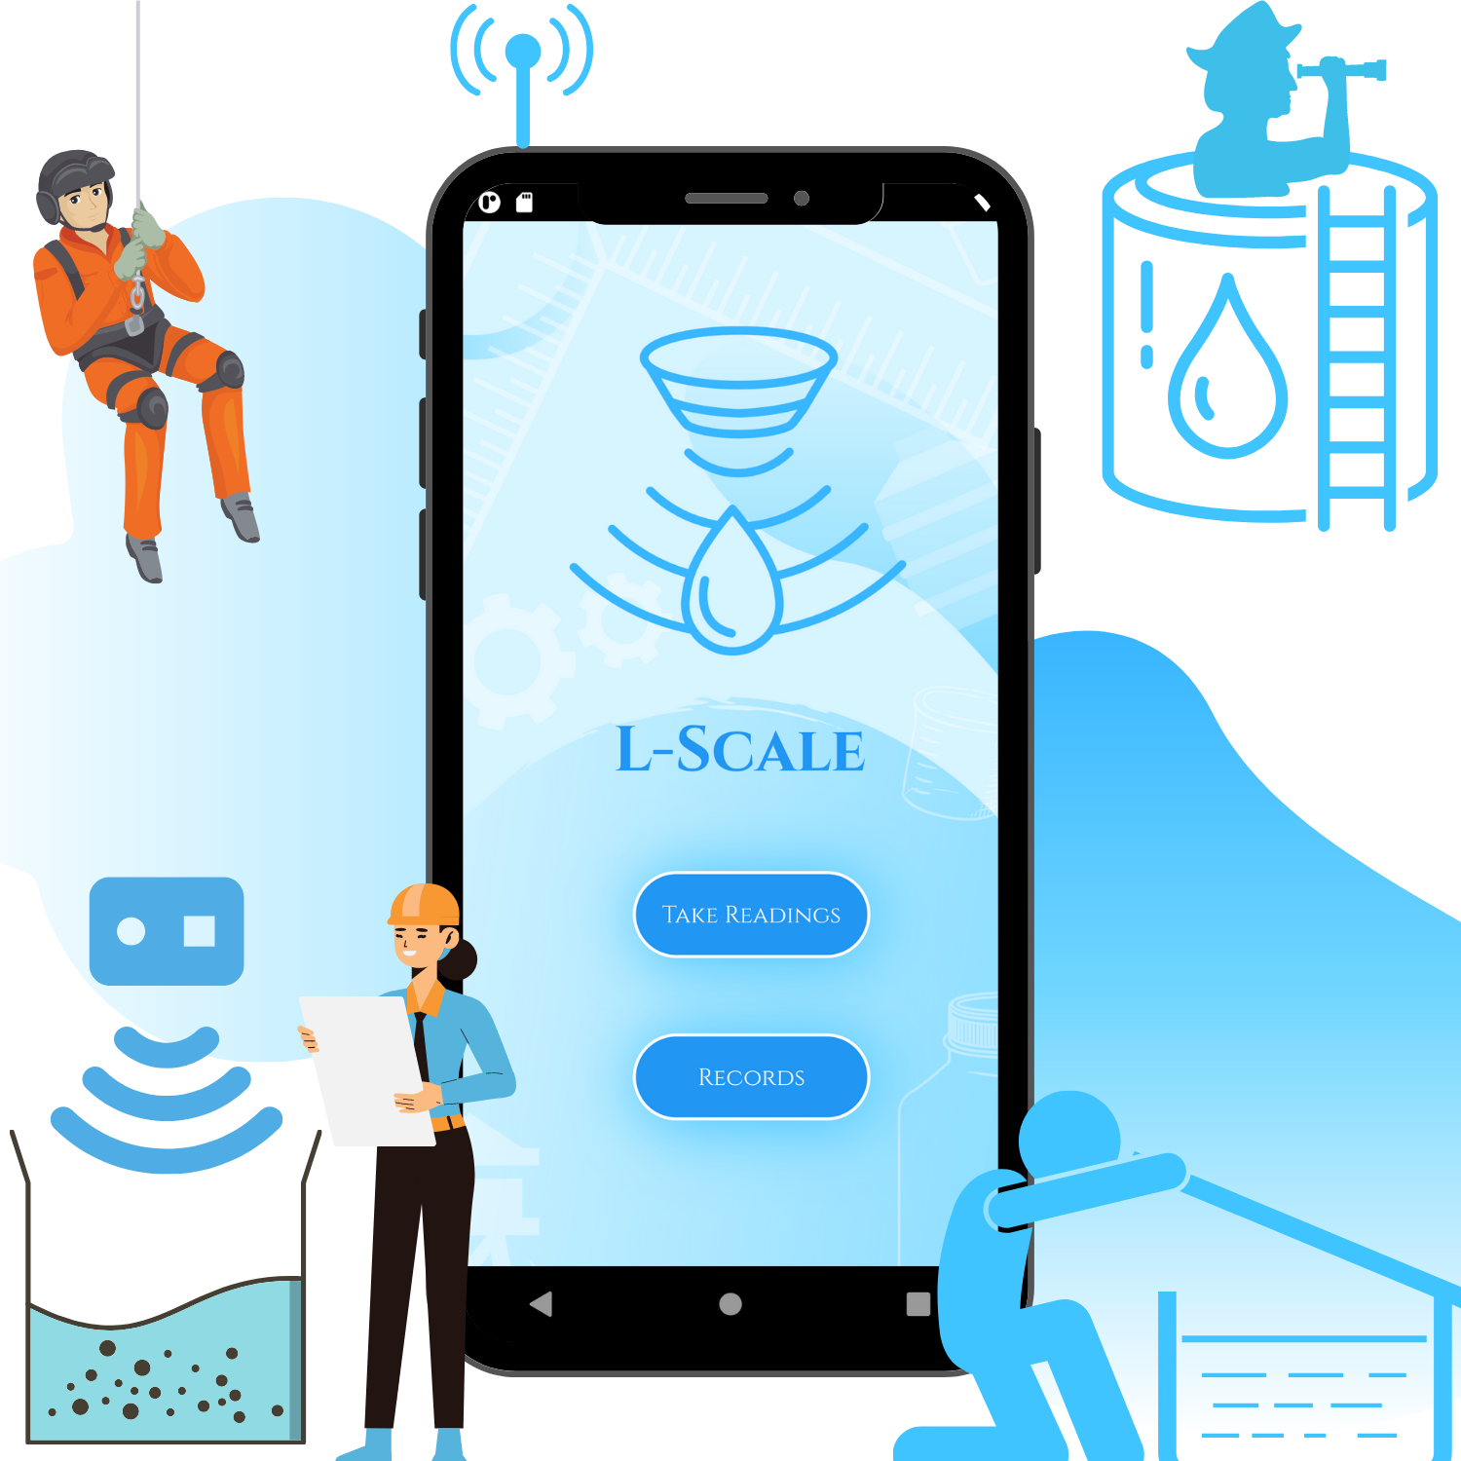

Developed by Team 220 volts
L-Scale
Application for tracking liquid levels
Kanav Bhasin (Email: kanavbhasin22@gmail.com)
Daksh Nauni (Email: mr.codefrost@gmail.com)
Yakshit Gupta (Email: guptayakshit@gmail.com)
Tanish Kamdar (Email: tanishkamdar@gmail.com)
Developed for HackOFiesta-Flagship Hackathon of India

Slide 2


PROBLEM STATEMENT
“LACK OF LIQUID LEVEL MONITORING INSTRUMENTS”

Slide 3
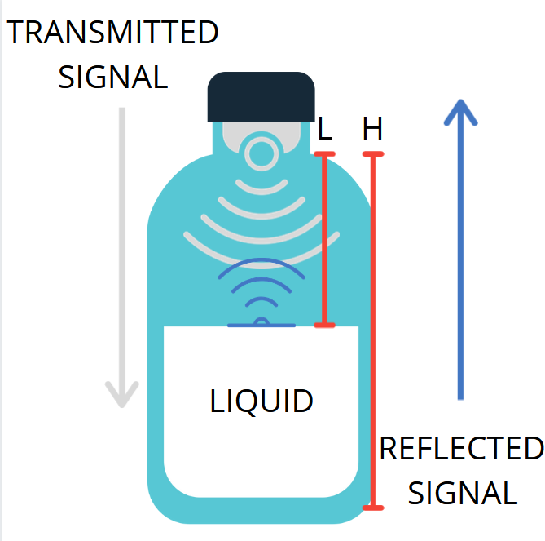
L-scale variants
PROPOSED SOLUTION : L-SCALE
L-scale is a software-hardware integrated project developed for Liquid level Tracking .
fixed L-scale
mounted on a container/vessel/object
Sends data using api via internet to the app
portable L-scale
Can be mounted on a container/vessel/object
Can be removed from a container/vessel/object
Sends data using Bluetooth module to the app

Slide 4

How does it work?
PROPOSED SOLUTION : L-SCALE
Ultrasonic
Sensor
Arduino UNO
HC-05 Bluetooth Module/ ESP8266 (API)
Flutter App
ULTRASONIC LEVEL DETECTORS OPERATE BY GENERATING AN ULTRASONIC PULSE AND MEASURING THE TIME TAKEN FOR THE ECHO TO RETURN.
THE ADVANTAGE OF ULTRASONIC LEVEL DETECTOR INCLUDE ITS NON-CONTACT USE AND SUITABILITY FOR VARIOUS LIQUIDS.

Slide 5
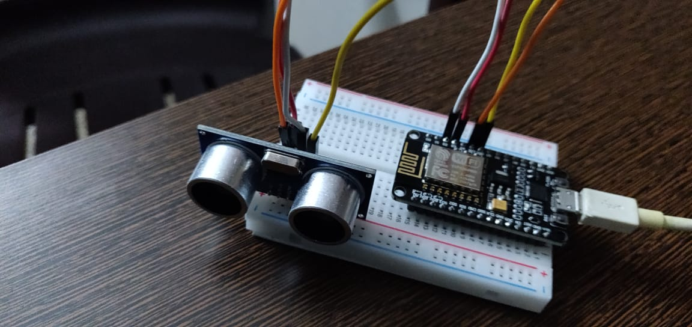

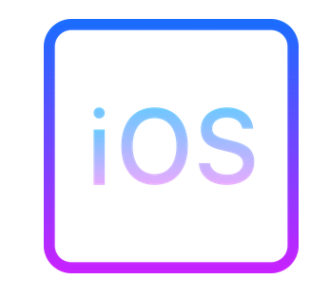



Hardware
PROPOSED SOLUTION : L-SCALE
software
L-SCALE uses flutter as the end user application framework
Flutter allows the app to be cross platform
The app receives data using either bluetooth or fetch it from api depending upon the variant of the l-scale
It consists of an ultrasonic sensor and a nodemcu. It is to be used as a lid for the container to be moNitored

Slide 6
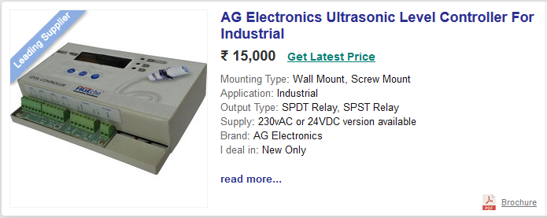
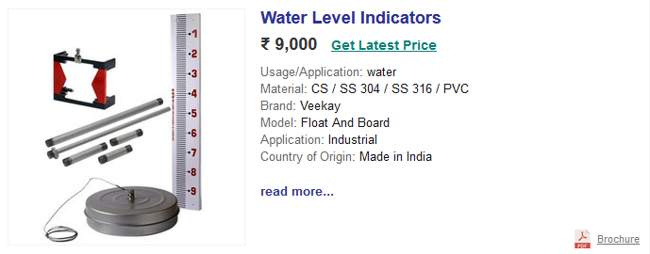
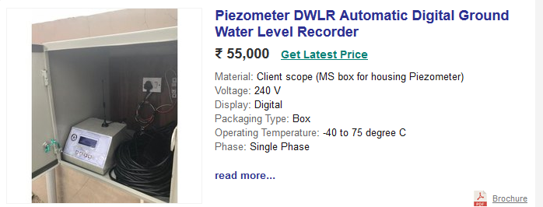
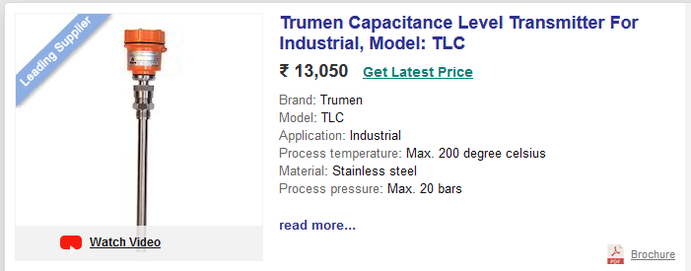
L-scale
UNIQUE SELLING POINTS
 | L-scale | Current tools
Portability | Fixed/Portable | Fixed only
Estimated Cost | Under 1,000 Rupees (850 approx.) | 7,000-16,000 Rupees
Connectivity | Wireless- API(Internet)/Bluetooth | Wired
Accessibility | Flutter App on Phones/PCs | Small Display on device (if any)
User Interface | App UI | Mechanical buttons (if any)
Application | Multi-Utility tool | Single purpose tool

Slide 7


L-scale : It’s original !
UNIQUE SELLING POINTS
No ! We don’t mean L-Scale has modern features or that it has a portable variant.
We mean that “THERE ARE NO LIQUID LEVEL MONITORS THAT USE ULTRASONICS”
There are only “ CONTROLLERS” which use the ultrasonics but no Monitors(Trackers).
Current Monitors are either Mechanical/Capacitance based and come with the same set of issues as discussed in previous slide.
Feel free to ask Google !

Slide 8


UNIQUE SELLING POINTS
USE CASE – Simple Water level tracking
USE CASE – INDUSTRIAL LIQUID TRACKING
INDUSTRIAL LIQUIDS CAN BE HAZARDOUS AND CUMBERSOME TO KEEP A TRACK ON. L-SCALE CAN MAKE THE PROCESS REALLY EASY and trackable for the users.
L-scale is contactless so is protected from damage or corrosion
WITH ACCURATE MEASURING IT CAN KEEP A PROPER CHECK ON THE LIQUID LEVELS.
Tracking water levels in tanks, containers, bottles, etc.
Sending the calculated water percentage to the concerned user directly to his/her device.

Slide 9


UNIQUE SELLING POINTS
USE CASE – RESCUE OPERATIONS
USE CASE – EXPLORATION
L-SCALE IS VERY HANDY AND CAN BE VERY USEFUL to explorers in their exploration drives.
It allows detailed study and tracking of water levels be it rivers, canals, caves or newly explored water bodies.
Detailed analysis with the help of L-scale can prove to be very helpful in rescue operations.
HELPS IN KEEPING A RECORD OF WATER LEVELS IN SUBMERGED REGIONS allowing proper management of the situation.

Slide 10




UNIQUE SELLING POINTS
USE CASE – DISASTER MANAGEMENT
USE CASE – MUNICIPALITY
L-SCALE IS THE TOOL THAT CAN HELP AT PREVENTING HAZARDS FROM HAPPENING IN PLACES that are prone to floods.
SURVEYS CAN BE EASILY PERFORMED WITH IT TO CHECK DAM WATER LEVELS AND OTHER WATER BODIES THAT. CAN CAUSE FLOODS IN LOW LYING AREAS AND FLOOD PRONE REGIONS.
USABLE IN MAINTENANCE OF WELLS.
ALLOWS EASY ANALYSIS TO PERFORM PROPER MAINTENANCE/CONSTRUCTION OF SEWERS.
READING UNDERGROUND WATER LEVELS BEFOrE COMMENCING UNDERGROUND CONSTRUCTIONS.

Slide 11


TECH STACK
FLUTTER
THINGSSPEAK API
CLOUD
Arduino UNO
ESP8266 Wifi MCU
Internet of Things
Sensors

Slide 12
BUSINESS IDEA
L-SCAle as a business
TARGET AUDIENCE
BUDGET
Industrial Usage – Can be used in Water Treatment Plants, Chemical Plants etc.
Maintenance – Can be used in municipal services such as cleaning sewage
Exploration – Can be used in mines, caves and rescue operations etc.
Fixed L-Scale will be cheaper due to lack of Bluetooth module and stable mounting
Portable L-Scale will be an inexpensive option for Explorers, Field Engineers, Rescue Operators.
MARKETING
FEASABILITY AND USAGE
Many National/State/University Level programs have been launched in support of IOT projects as Atma Nirbhar Bharat currently. We plan to use this opportunity to get support from such programs.
L-Scale is a Multi-Utility IOT Device with support app, created to record and display user’s measurements. It is a low cost device that contributes directly to several utility and industrial purposes.

Slide 13

Motive Behind l-scale
MAKING PROFICIENT LIQUID LEVEL TRACKING POSSIBLE BY:-
USING ULTRASONIC SENSORS FOR ACCURATE MEASURES.
KEEPING A 24X7 CHECK ON LIQUID LEVELS.
EASY MONITORING WITH THE HELP OF TRACKING SOFTWARE AND USER FRIENDLY INTERFACE.
ITS CONTACT-LESS USE AND SUITABILITY FOR VARIOUS LIQUIDS.
MULTI-UTILITY DEVICE.

Slide 14

Current Features Of l-scale
FUTURE UPDATES
Live Liquid Level Tracking
Automatic volume calculator
Cross Platform App ( Available on Android, iOS, Desktop & Web)
Beautiful User Interface
API CONNECTIVITY
DEPTH MEASURES AND MONITORING
BLUETOOTH CONNECTIVITY
CLOUD STORAGE
BETTER REPRESENTATION OF DATA

Slide 15
Photo Shoot

Slide 16




